Slide 1


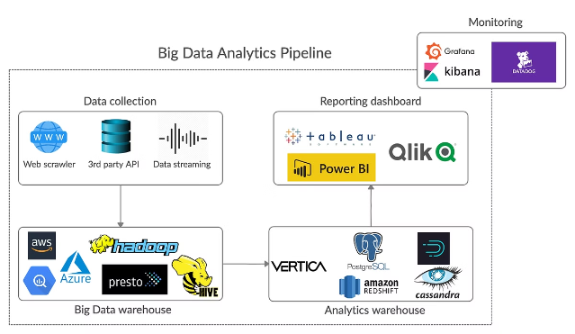
Introduction to the Big Data Analytics Pipeline Project
Explore the key components of a cloud-based big data analytics pipeline for processing and analyzing large volumes of data.
S Sai Sravan
192210668
CSE

Slide 2

Data Ingestion: Collecting and Ingesting Large Volumes of Data
Identify Data Sources
Validate and Transform
Determine the various data sources to be integrated.
Ensure data quality and perform necessary transformations.
1
2
3
Ingest Raw Data
Collect and ingest the data into the pipeline.

Slide 3
Data Processing: Leveraging Apache Spark or Hadoop for Data Transformation and Analysis
Apache Spark
Apache Hadoop
Data Transformation
Leverage the powerful in-memory processing capabilities of Apache Spark.
Utilize the distributed processing power of Apache Hadoop.
Clean, transform, and prepare the data for analysis.

Slide 4


Data Storage: Optimizing Data Storage Solutions for Scalability and Performance
Object Storage
Distributed File Systems
Leverage scalable and cost-effective object storage solutions.
Utilize distributed file systems for high-performance data access.
Database Integration
Integrate with SQL and NoSQL databases for structured data.

Slide 5

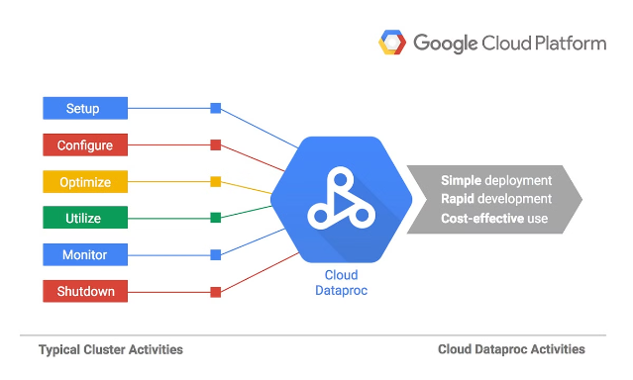


Cloud-based Infrastructure: Utilizing AWS EMR or Google Dataproc
AWS EMR
Google Dataproc
Managed Hadoop and Spark cluster on AWS.
Fully managed Hadoop and Spark service on Google Cloud.

Slide 6
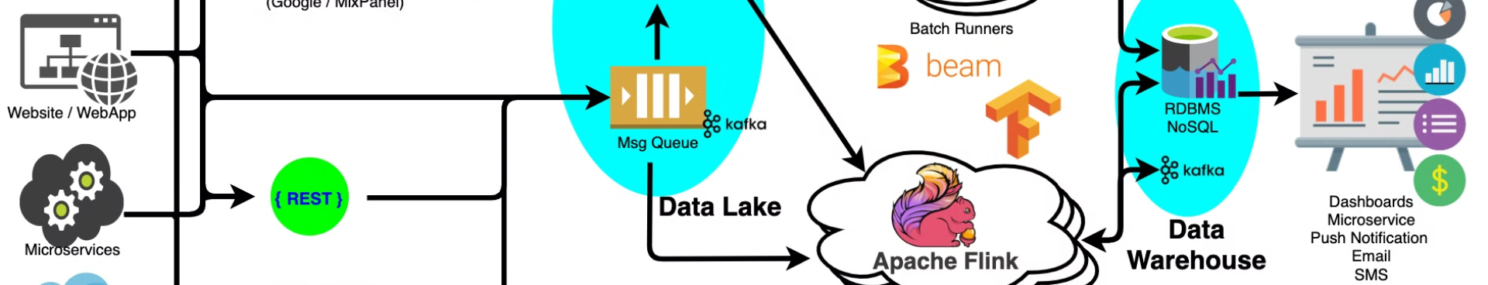



Scalability and Performance Considerations: Partitioning, Cluster Sizing, and Cost-effectiveness
Data Partitioning
Cluster Sizing
Cost Optimization
Optimize data organization for efficient processing.
Scale resources based on workload and performance needs.
Ensure cost-effective utilization of cloud resources.

Slide 7
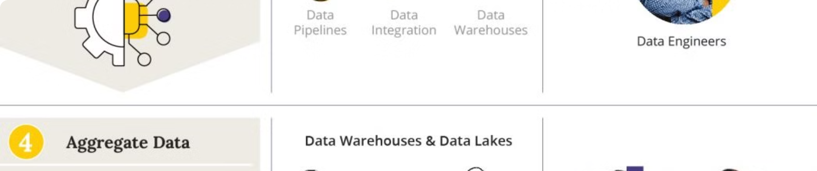
Data Analysis and Insights: Extracting Valuable Information from the Data
1
Exploratory Data Analysis
2
Machine Learning Models
3
Data Visualization
Uncover patterns, trends, and anomalies in the data.
Develop predictive models to generate actionable insights.
Create interactive dashboards and reports for stakeholders.

Slide 8


Conclusion and Next Steps
Efficient Processing: The pipeline streamlines the collection, storage, and analysis of large data volumes.
Actionable Insights: It helps uncover valuable insights that drive informed decision-making.
Integration: Combines various tools and technologies to handle complex data challenges.
Improved Efficiency: Enhances organizational efficiency and strategic planning.
Challenge Management: Addresses issues like data quality and system scalability for better results.

Slide 9


